Slide 1
BROOMRAPES
Group 8: Hugo Mahatdejkul, Ni Tang

Slide 2

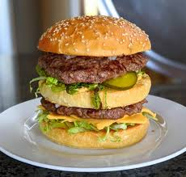
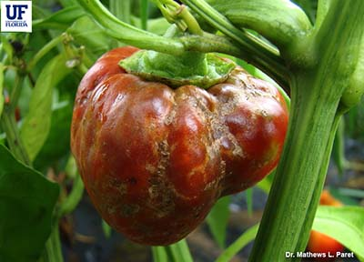

The Story
How did we get to this point?
Memories from the past
The Big Mac Data Set
The Superior Broomrape Data Set
Notes:
How did we get to this point? OG started w/ Big Mac Data set. Ni Subtly hinted that was stupid and introduced me to what she was doing in her lab… we’ll get to this in a minute…
In my mind I was thinking how familiar it sounded and I realized that she was studying a class of plants that I had learned about 2 years ago when I took BIS 2c w/ prof ledford.
Instantly realized that was the better option than Big Macs. Swapped it up to the Bloomrape data her lab gatheredgathered
Note: pretty cool how what I learned 2 years ago actually came in handy because I was 100% sure I would instantly forget everything about bis 2c the moment the final ended.

Slide 3
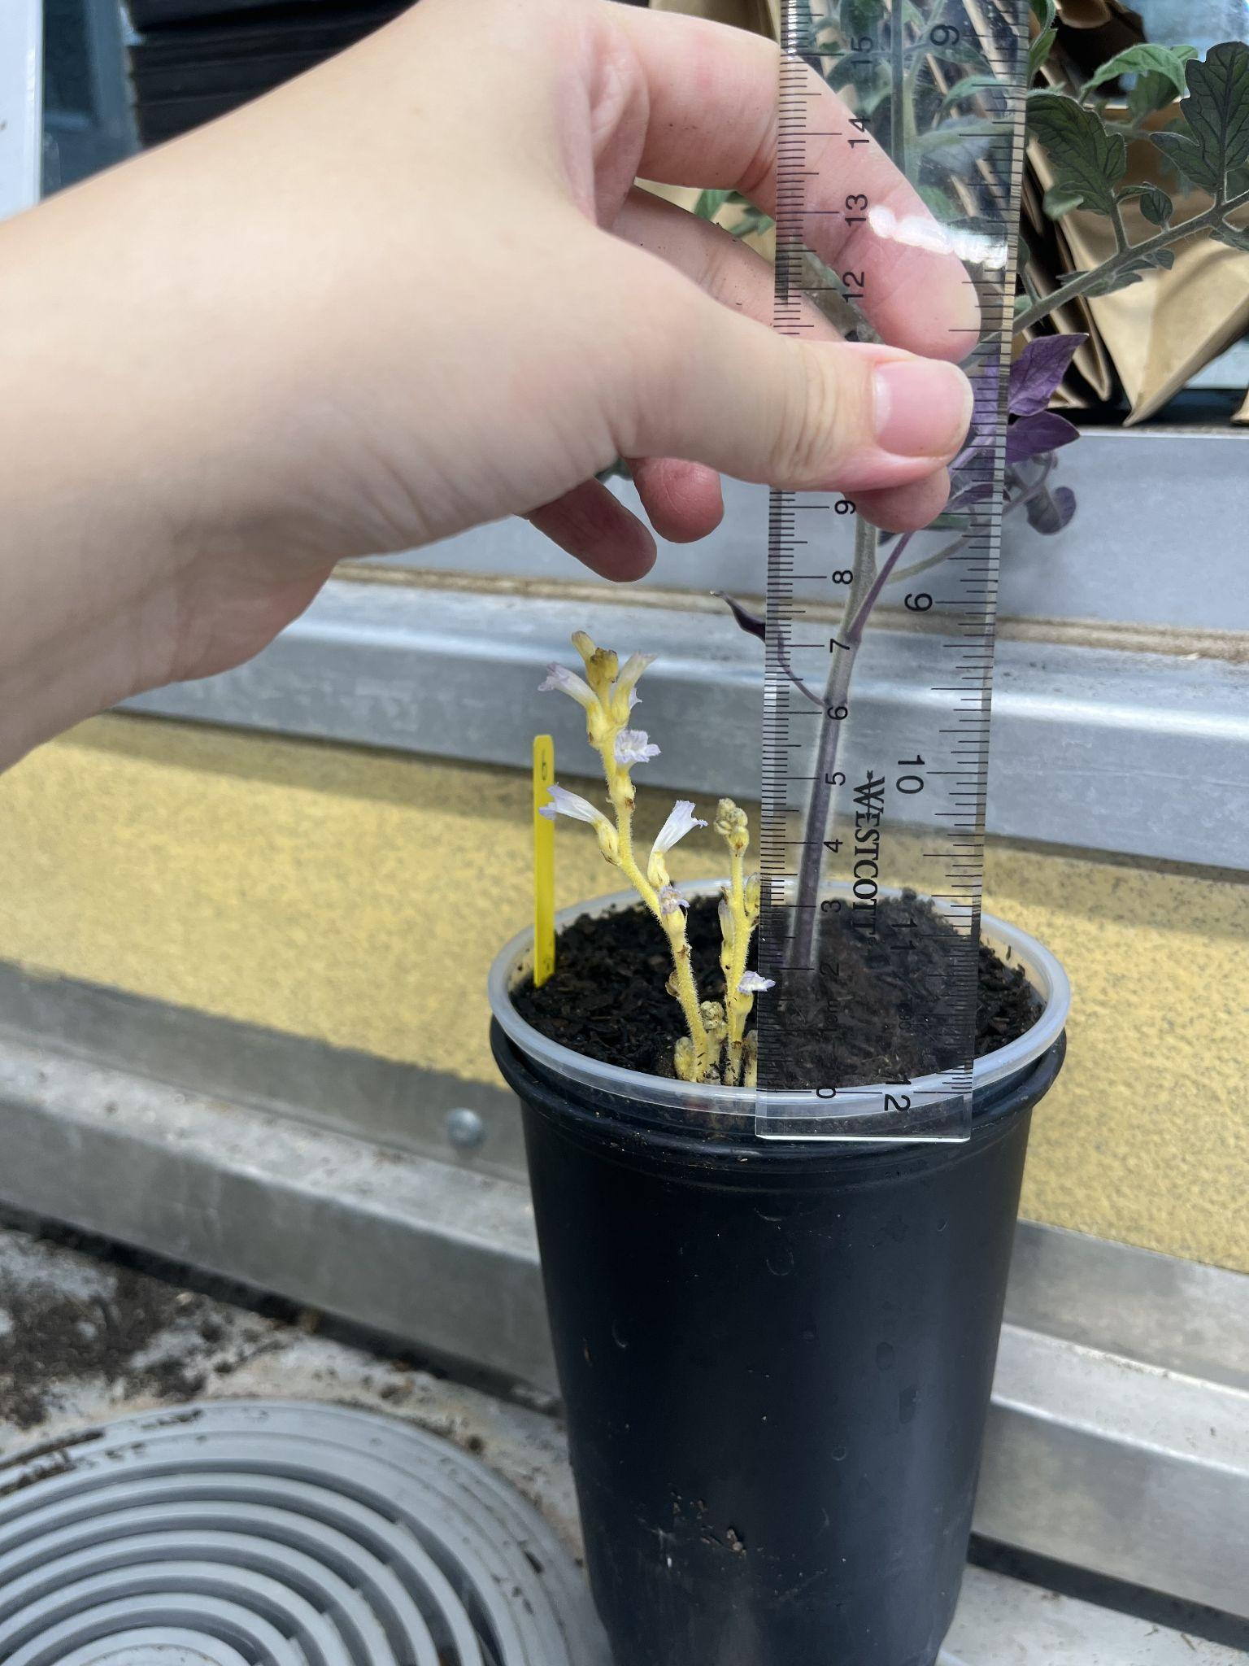
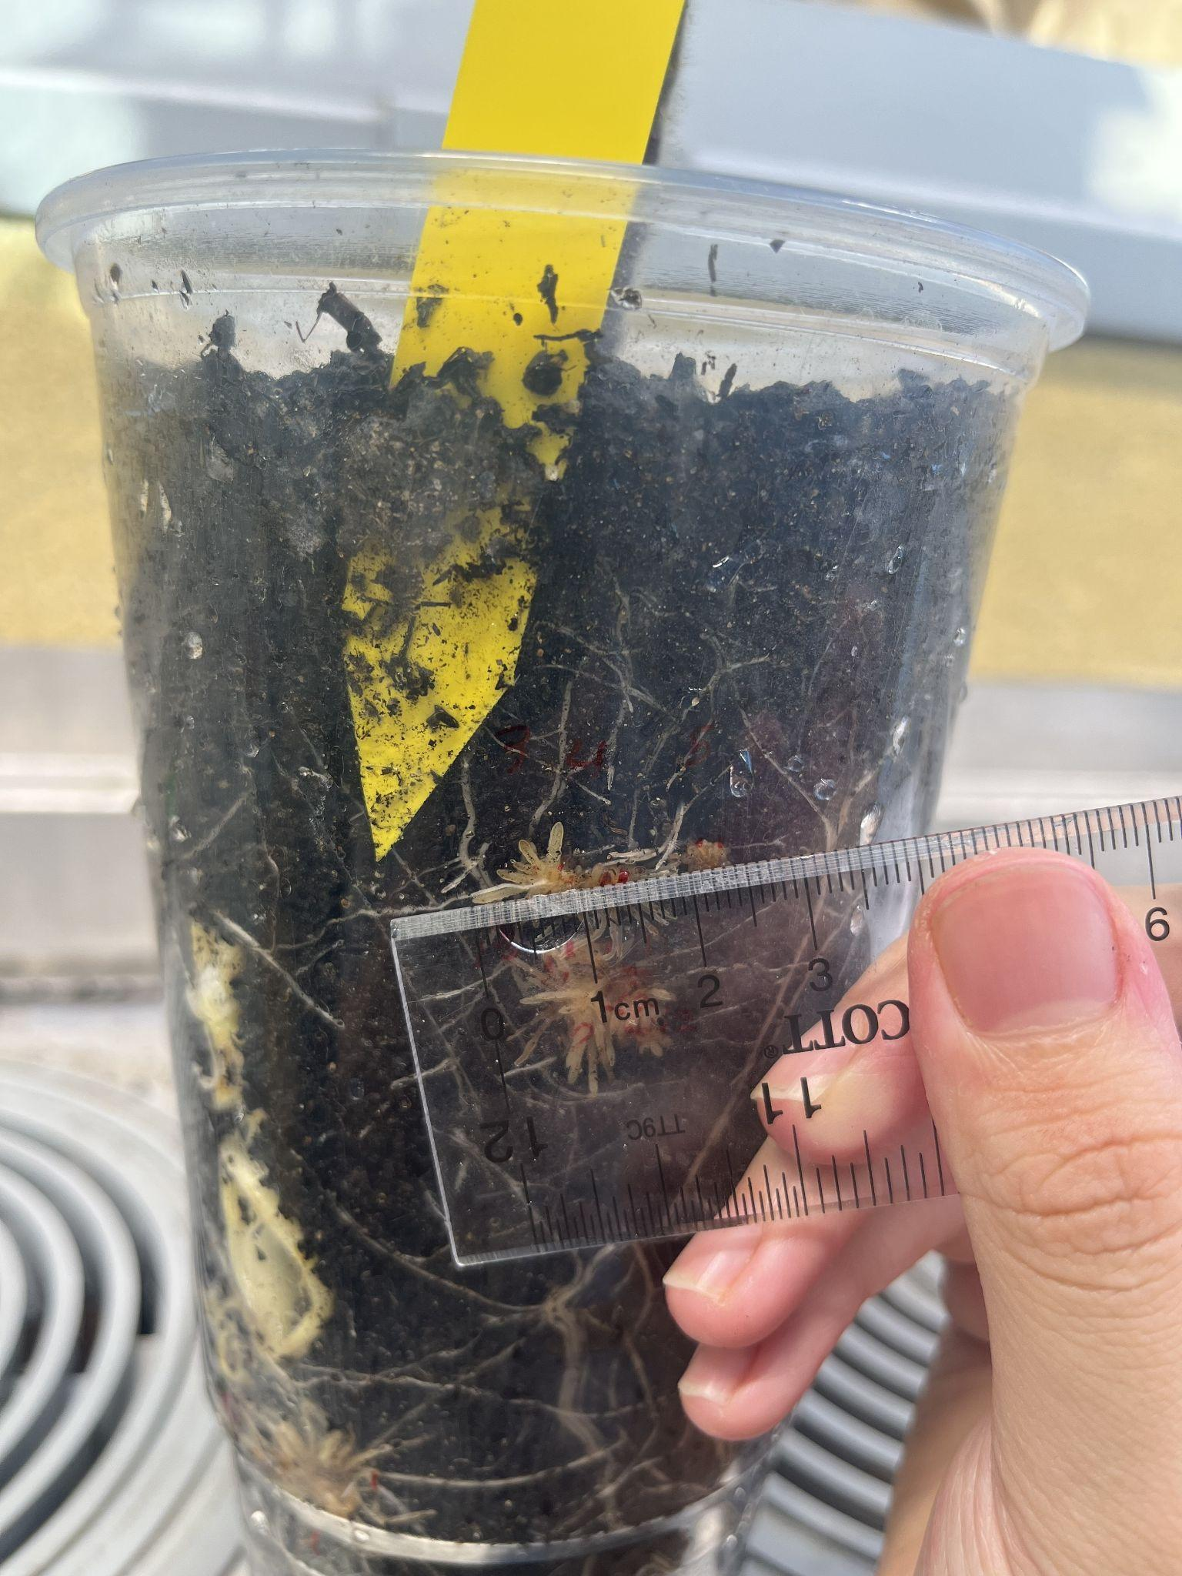
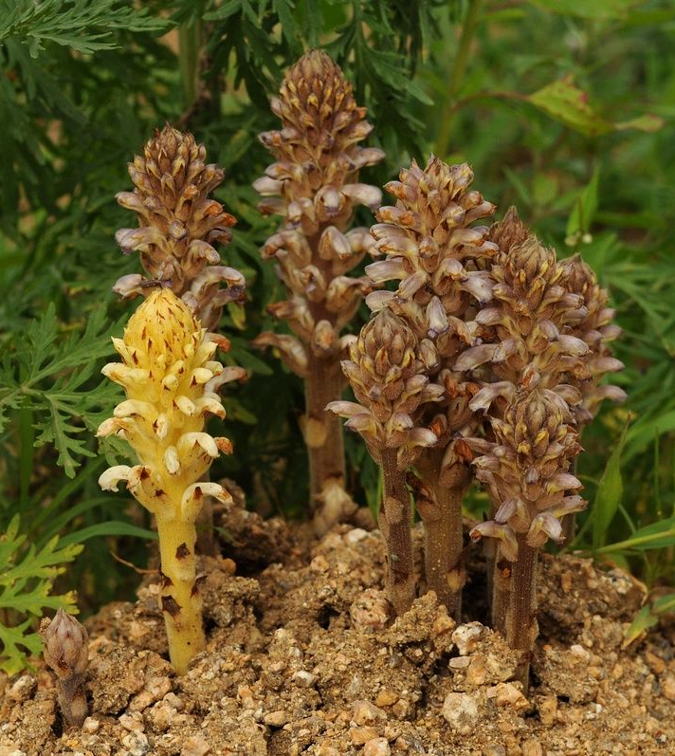
What is Broomrape?
Top:Figure 1. Mature Branched Broomrape on Tomato Plant
Bottom:Figure 3. Sunflower Broomrape
Sunflower Broomrape(Orobanche cumana Wallr.)is a parasitic plant causing devastating effects. When the broomrape seeds sense plant hormones, usually GR24, from the host’s roots, they starts growing and attaches to the root. After ~14 days, they emerge and have flowers. Broomrape is a big problem because they have really small seeds which can be spread by trailer and transplanters. In Yolo County, Tomato Broomrape/Branched Broomrape is also causing major tomato plants destruction.
A Growing shoot
Figure 2. Branched broomrape’s attachment on tomato plant

Slide 4
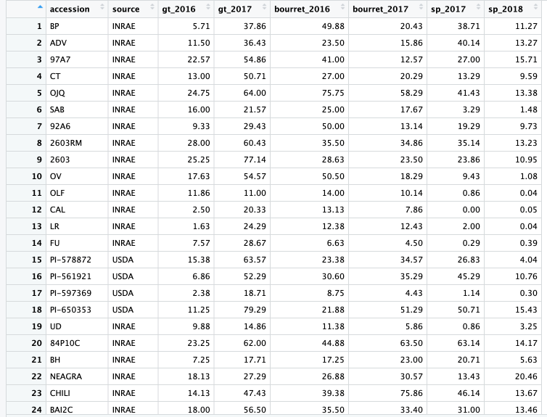

Slide 5
Data/Methods
Data Cleaning: clean_names to unite the names of variables, pivot the original table longer to fit actual need of data analyzation and plotting, separate broomrape type and the year when experiments were done.
Data Analyzation and Visualization: summarise, top_n and geon_col() mainly. Two plots are constructed.
App Construction: shinyapp is used to construct an app. User can choose different sunflower origin and accession to compare their broomrape resistance.

Slide 6
Reference
https://powo.science.kew.org/taxon/urn:lsid:ipni.org:names:662284-1
Caldero ́ n-Gonza ́ lez A, Pe ́ rez-Vich B, Pouilly N, Boniface M-C, Louarn J, Velasco L and Muños S (2023) Association mapping for broomrape resistance in sunflower.
Front. Plant Sci. 13:1056231. doi: 10.3389/fpls.2022.1056231

